Slide 1
Customer Booking Prediction
Predict whether a customer will make a booking based on historical data.

Slide 2
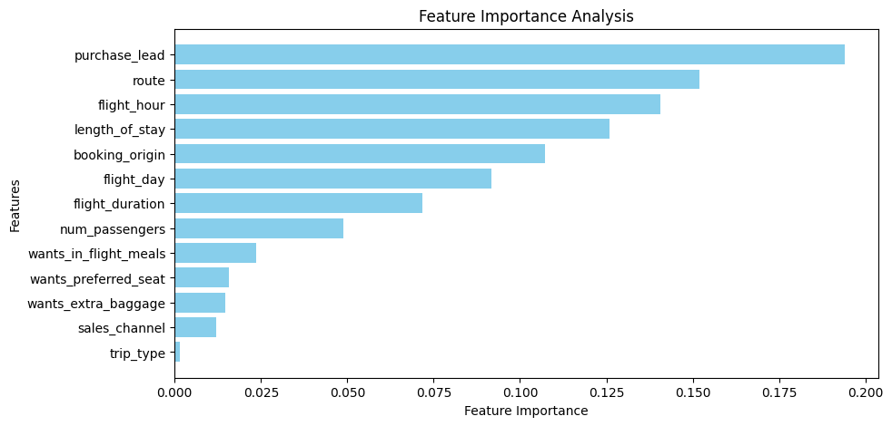
Data Preparation & Feature Engineering
✅ Removed less important features (e.g., trip_type, sales_channel) ✅ Handled class imbalance using SMOTE ✅ Encoded categorical variables & normalized numerical values

Slide 3
Metric | Before SMOTE | After SMOTE | After Tuning
Accuracy | 85.34% | 79.83% | 78.19%
Booking Recall | 10% | 36% | 44%
Booking Precision | 56% | 34% | 33%
Model & Performance
Algorithm Used: RandomForest (optimized with GridSearchCV)
📊 Key Insight: The model now correctly identifies more bookings (recall 44%), even though overall accuracy slightly dropped.

Slide 4
Feature Importance
Top predictors for booking likelihood: 🔹 Flight Duration 🔹 Departure Time 🔹 Fare Price
Next Steps
🚀 Deploy the model for real-time booking predictions 📊 Monitor performance & adjust threshold if needed 🎯 Explore ensemble models for further improvement

